Slide 1
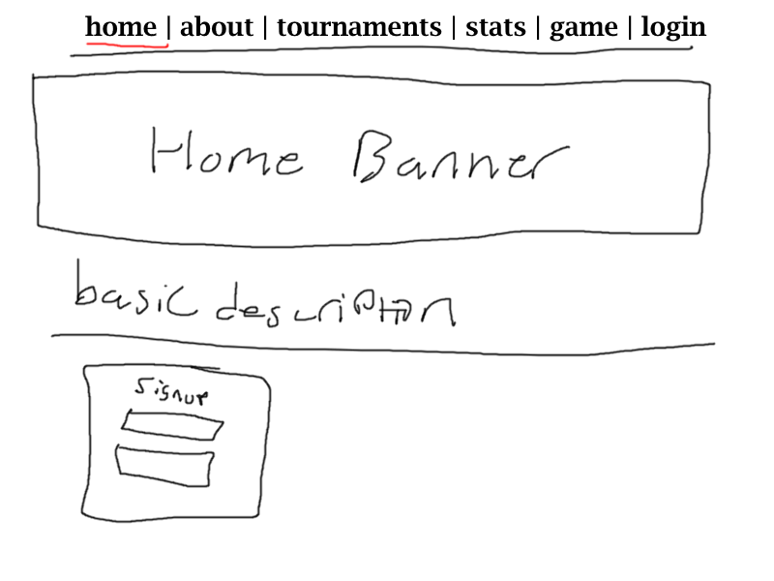
Notes:
It seems like most websites these days don’t have a true homepage with lots of embellishments and “about us” kinda junk, especially if they're trying to sell you something. Amazon, apple, Williams Sonoma, etc all have products on their main pages right off the bat. WSJ has news and stock tickers on homepage. Wikipedia kinda has one, but its pretty unceremonious and has a bunch of links on it anyways. Also, I drew these sketches in paint.net with a mouse so they're gonna suck.

Slide 2
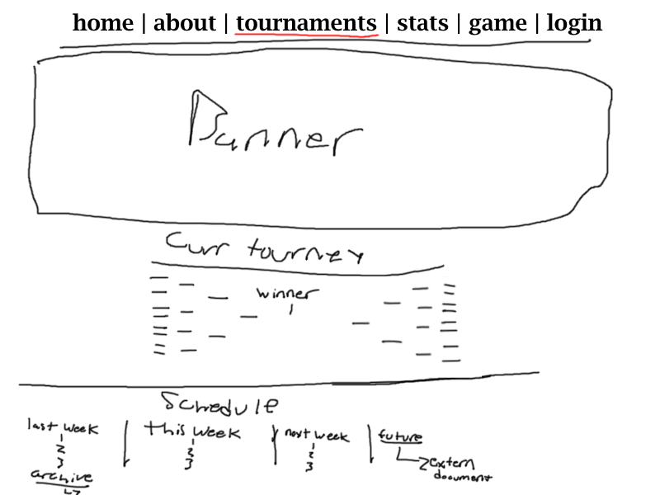

Slide 3
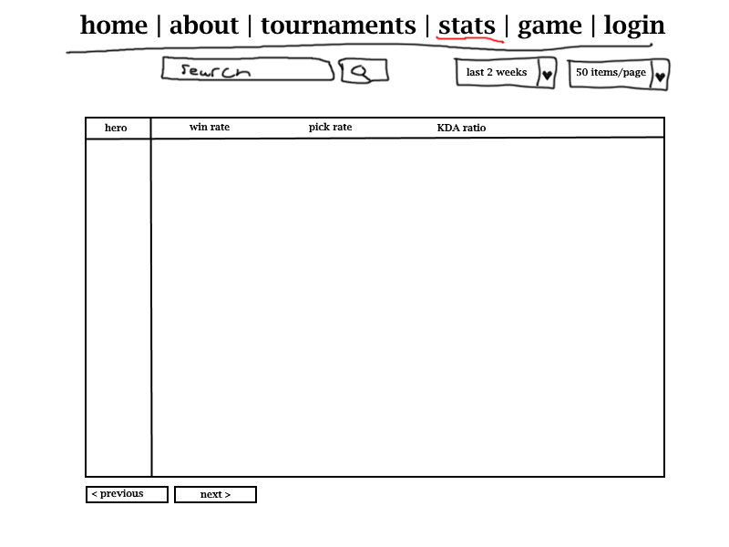

Slide 4
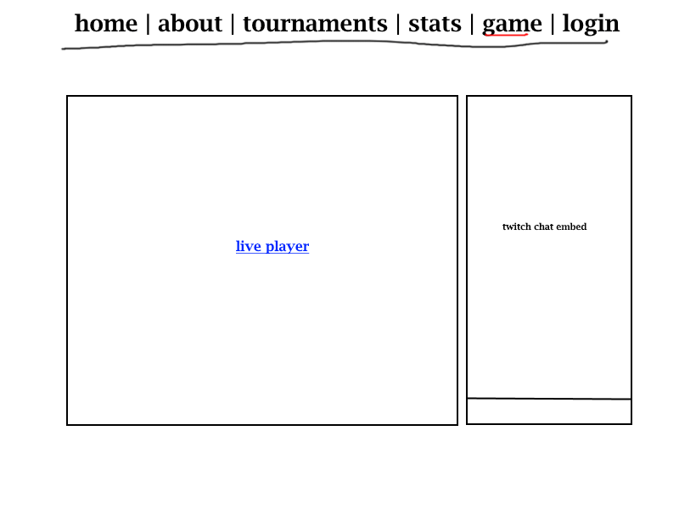

Slide 5
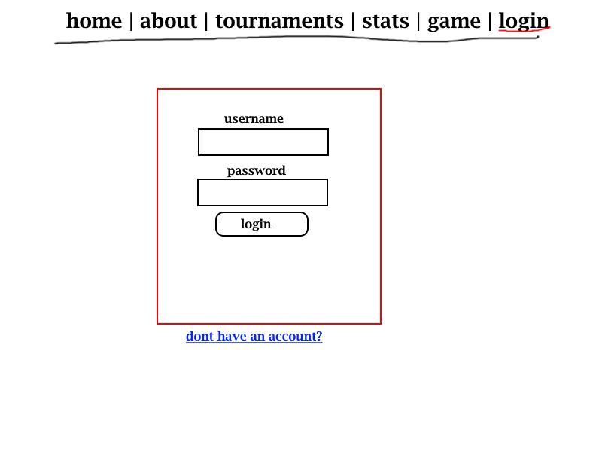

Slide 6
